Slide 1

SECTION 1-(1 )
Total Claims | 6927
Average value of claims | £ 2995.66
% of Claims to Policies | 6.90%

Slide 2
Trends
Year | 2018-19 | 2019-20 | Changes
policies | 51,616 | 48,386 | 3230 (6%)
Net Written premium | £ 19,498,444 | £ 16,928,932 | £ 2,569,512
Net Earned premium | £ 17,807,539 | £ 9,429,686 | £ 8,377,853
% | 91% | 56%
Total claim amt | £ 13,916,460 | £ 6,834,518 | £ 7,081,941
% of claim amt to net written premium | 71% | 40%

Slide 3
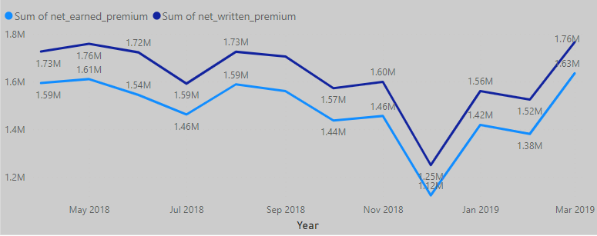
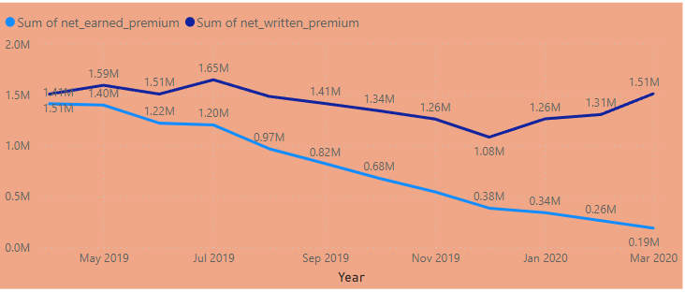
There is a significant difference in the net earned premium and net written premium in the year 2019-20 as compared to 2018-2019.
The gap seems to widen since July and we shall have to investigate the reasons for the same. The difference is very prominent in FEB & Mar 2020 when the pandemic and uncertainty was creeping in, people were unable to pay their premiums.

Slide 4

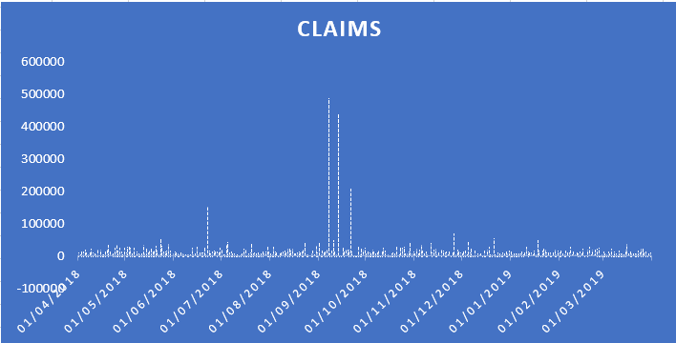
There seems to be a huge difference in the claims amount. The reasons could better anti-fraud software installed, better and sophisticated claim prediction models used, from the resulting efficiency, competitive price can be offered to the customers. Also towards the end, due to the pandemic, vehicles were off the road due to lockdown and that could be amongst some of the reasons for lower claims.

Slide 5
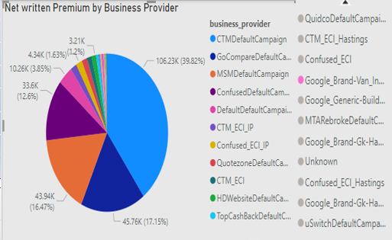
Month wise comparison of net written premiums

Slide 6
The premiums seem to be lower in December in both years and higher during March and April, A month-wise breakdown shows that except in July, there seems to be a decrease in premiums in all the months as compared to the previous year. This must be investigated. We could see if certain areas or certain business providers/campaigns show a decrease. An area-wise breakdown might be possible. Could it attributed to competition, pricing.

Slide 7
CAPPED INSURANCE
50000
Limit claim to agreed amount
Manage Risk
Reasonable
Extra protection:
Certainty:
The capped incurred column signifies that the insurance claim has been capped at 50000.
It is a contractual agreement that a client can only claim damages up to the amount agreed, even if the law would otherwise award a greater sum in damages.
The cap is usually lower than the cover and used as a way to manage liability and to ensure that there is a fair allocation of risk.
They are enforceable as long as they are properly incorporated into the contract and are at a ‘reasonable’ level i.e. not significantly lower,
It’s possible that the amount of damages claimed could be in excess of the amount covered by the policy and so the cap is just an important way of providing a level of extra protection to the insurer from aggressive claimants.
Provides more certainty to the insurer as to the maximum liability with a client.

Slide 8
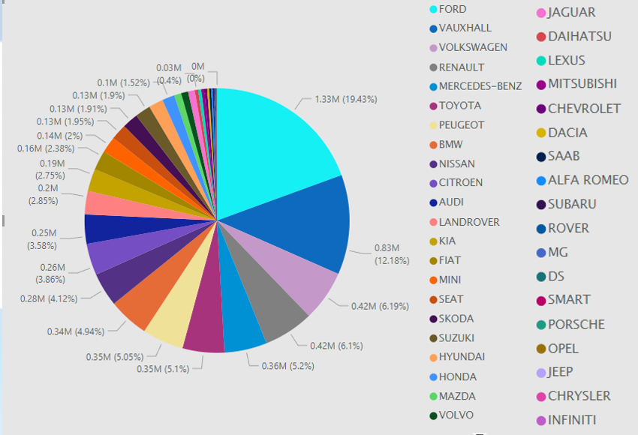
SECTION 1-(2)
AVERAGE CLAIM SIZE BY A VARIETY OF FACTORS:
TO ASSESS THE MOST IMPORTANT PREDICTORS OF INDIVIDUAL CLAIM SIZE.
- WHY THESE FACTORS ARE IMPORTANT
1. Vehicle make
Luxury Cars-more expensive claims
Fast Cars-More accident prone, expensive repairs.
Older cars-safety and security features, cost of repair or replacement of parts, however less powerful engines reduce the probability of an accident. I
Insurance Co that takes into account factors like the make, the year, the model, the transmission, the fuel, etc.
More expensive cars are prone to get stolen-impacts the size of the claim.
Size of the car –higher claim amount.

Slide 9
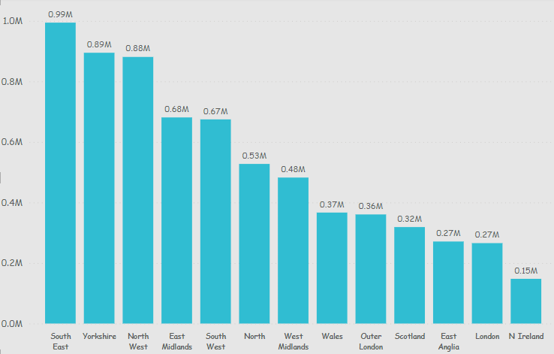
2. Region
Density of population and traffic
Thefts & Vandalism are higher in urban areas.
Intersections and roundabouts in urban areas
Fraudulent claims-higher in certain areas.

Slide 10
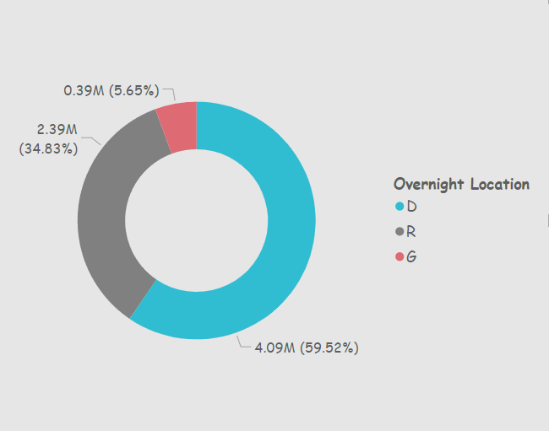
3. Overnight Location
The risk and probability of theft and vandalism overnight are obviously less if the car is in the garage, as against it being on the street or in the driveway.

Slide 11
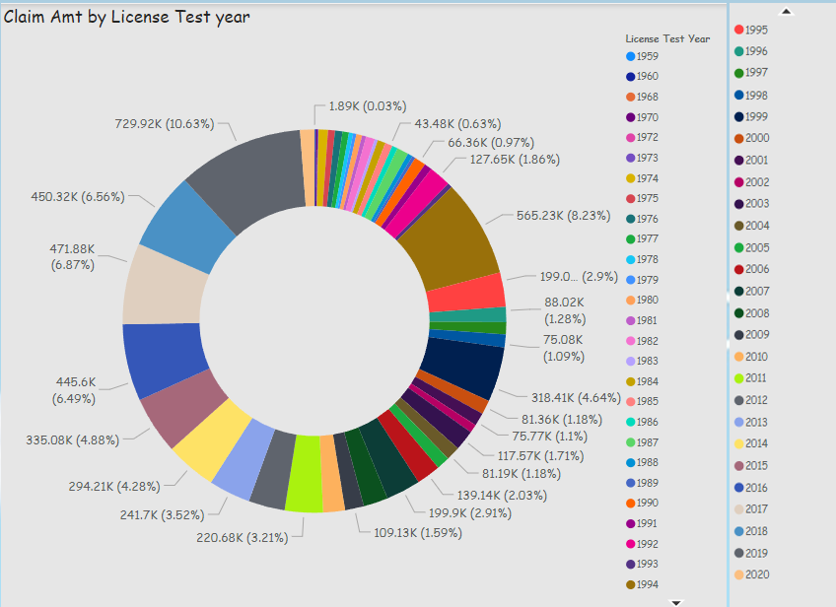
4. LICENSE TEST YEAR:
Older experienced drivers may have a lower probability of accidents but it is also possible that they can control the vehicle and incur less impact and damage.

Slide 12
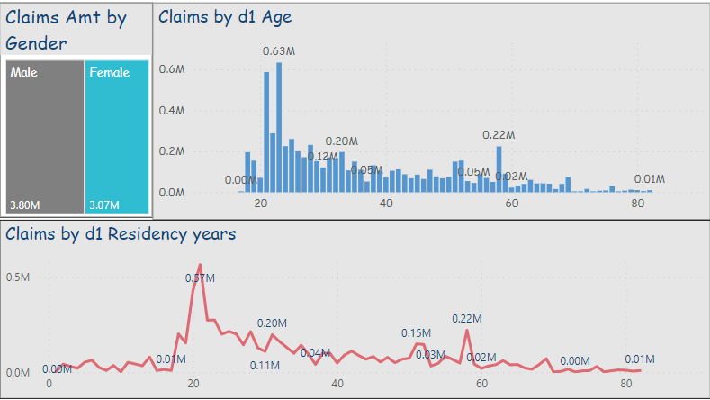
5. AGE & RESIDENCY: Some other Individual factors like gender, age, and residency might influence the value of the claim ,for instance, a younger non resident driver with less familiarity with areas and systems might impact the value of the claim through increased damage/impact to vehicle.

Slide 13
Section 1 (3) -Missing data and impact on the PREDICTIONS
Vehicle make is not known (NA) in 777 cases (0.7%).
There are 3396 cases of 0 values in net written premium/3580 cases for net earned premium. That would be about 3% of the total cases. The exposure in these cases is mostly 0.0027. In certain cases, even when the net written premium is 0, the net earned premium shows a value, sometimes even a negative figure. I am unsure what to make of it. Since it is just 3% of the total cases, I have ignored it.
Region not known for some areas (50 cases)- Also if specific areas are known like the postcodes, it would help identify certain trends. For instance, certain areas are more affluent with expensive cars and prone to robberies/vandalism and higher probability and claim amount, and certain areas may be prone to accidents due to more roundabouts, intersections, higher traffic, and population.
In certain cases, a claim must not have been made yet, for instance, it is possible that the person is recovering from bodily injuries and has not claimed yet.
The missing data can cause bias in the estimation of parameters during predictions. It can reduce the representativeness of the samples, thus creating a possible bias in the results.

Slide 14
SECTION 1 (4) –APPROPRIATENESS OF THE DATA USED
Volume of Claims/exposure: The volume of claims seems to increase with the increase in exposure.
Dataset is just for 2 years. If the data is available for more years, it could help spot more pronounced patterns and trends over the years.

Slide 15
Section 1-(5) How to use this information to build a model for predicting the ultimate individual claims amount
Claims amount is predicted by using the information available to
determine the probability of claim and the value of the claim.
Risk through Vehicle | Risk through Individual | Factors influencing Probability of claim | Factors influencing Value of claim
Vehicle purchase date | License test date | Region | Vehicle Value
Vehicle Make | Gender | Overnight location | Vehicle Make
Vehicle annual mileage | Age | License test date
Transmission | Residency years | Age
Vehicle use | Region
Vehicle Value | Number of claims
Overnight Location

Slide 16
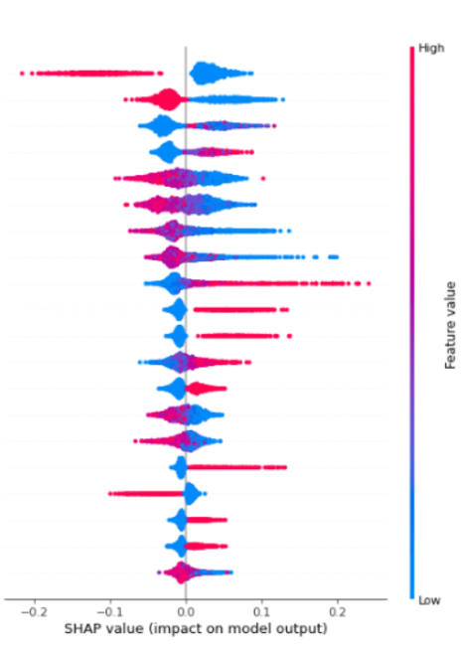
Feature
Importance
Rank the variables in descending order of importance
Value
Assign a categorical value depending on their value in the ranking of importance.
CorrelationThe impact of that value and the correlation between the value of the claim and that particular parameter.
Example: SHAP Value System-
Get the Power Set of F, which contains combinations of features
Run the model for all possible combinations,
Record the marginal contributions to the model output for f
Calculate a weighted sum of f marginal contributions to get the SHAP value (expected contribution) of feature f for a given output.

Slide 17
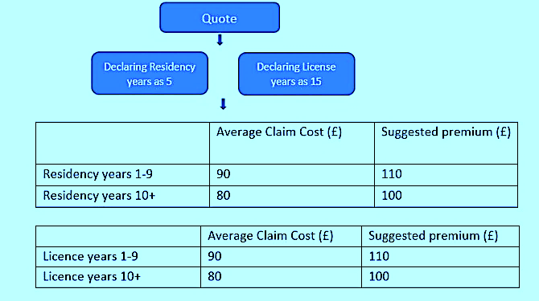
SECTION 2

Slide 18
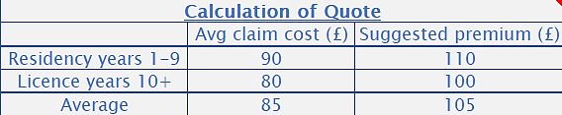
QUOTE

Slide 19
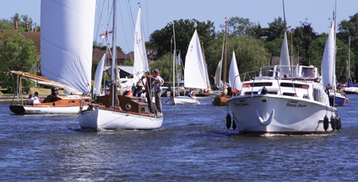

SECTION 3
Boat/Yacht Insurance
Post the pandemic,visit to blue spaces like canals, rivers, lakes and the coast has increased in popularity. According to a survey by British Marine, 23% of respondents indicated that they were likely to purchase a new boat or watersports craft within the next 12 months, with most interested in sailing yachts (32%), motor cruisers (25%) or powerboats (19%). Boat owners predominantly fall within the upper middle-class “AB” socioeconomic group, composed of higher income professionals and higher managerial occupations (constituting approximately 4% of the UK adult population), and the central middle-class “C1” group, consisting of junior managerial and professional occupations (constituting approximately 28% of the UK adult population). The highest proportion of owners in the “AB” socioeconomic group belong to the more expensive sailing yacht and motor yacht boat segments, with almost half of boat owners belonging to this social grade.
The Recreational Boat and Yacht Building industry, UK has performed well for much of the period, until the turmoil caused by the COVID-19 (coronavirus) pandemic.
Industry revenue is anticipated to expand at a compound annual rate of 0.9% to reach £1.2 billion over the five years through 2022-23.
Market Size: £1bn
Number of Businesses : 553 (IBISWorld Research)
“A new, younger wealthy generation of boat owners who are focused on “pursuing rare, tailored experiences over accumulating replicable things.”Ft.com

Slide 20
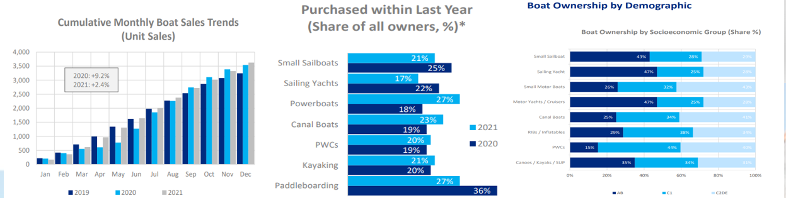
Some Industry Statistics
Source: Survey by British Marine

Slide 21
Swot analysis
(Best and worst RISK AREAS)
Strengths
Reputation & familiarity in the insurance sector
Existing customer market
Can be an intermediary
Weaknesses
New Entry
Competitors.
Fraud claims
Opportunities
Growing Industry
Wealthy individuals looking for unique + recreation/getaway with family/friends
4,700 miles (7,600 km) of navigable canals and rivers throughout the United Kingdom
Threats
Economic situation
Turmoil/supply chain disruption for Mfg
Environmental Regulations (MARPOL, COLREGS or SOLAS)
Uninsured/Untrained riders.

Slide 22
Customers | covers | FACTORS that determine the Insurance cost | What is not covered | Requirements | Optional extras
Owners of
Sailing/Racing Yachts
Motor boats
Dinghies
Jet skis
Third-party Cover (Cheaper): Liability to other people/property arising from ownership of the boat.
Fully comprehensive policy: Includes own loss i.e. accidental damage, vandalism, fire & theft,+ third-party cover.
Value of the vessel
Age
Sailing Area
Personal history of Owner (License, boating experience, qualifications, history of claims)
Speed
Survey report
Damage caused under the influence of drugs /alcohol
Boat left unlocked /unattended
Commercial use unless agreed upon
Survey report
Regular Maintenance.
Mooring the boat-notify insurer the address where it is kept, bank, boatyard, marina berth.
Legal helpline
Personal Possessions cover
Breakdown cover
Family and Friends Cover

Slide 23
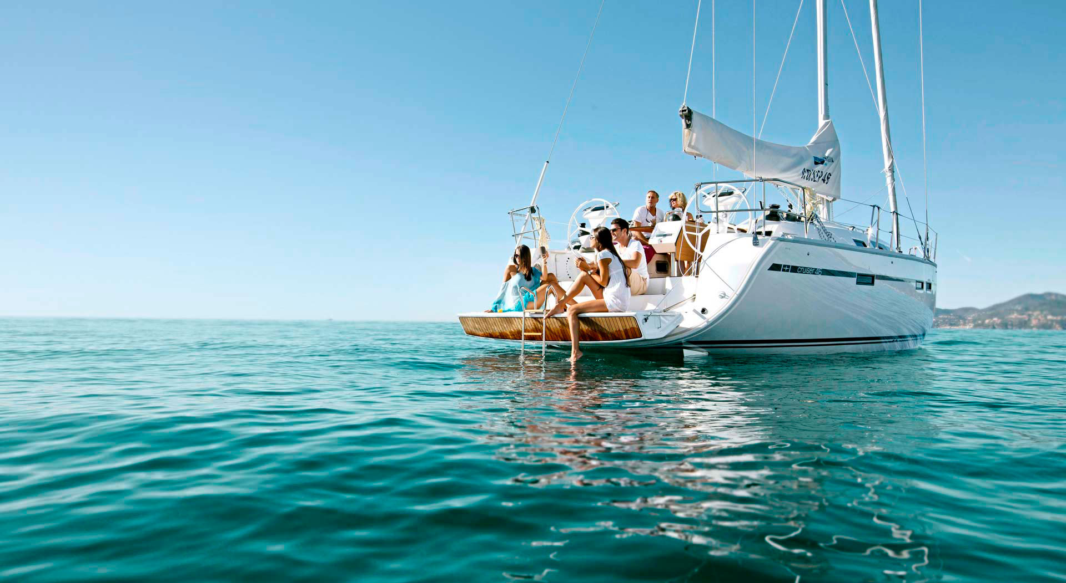


Launching
Yacht and Boat Insurance
Tailored to your requirements
for a Competitive Quote and Early Bird Discounts Call us at 0333 321 9790
www.hastingsdirect.com

Slide 24
PARTNER/COLLABORATE
with boat/yacht manufacturers and sellers.
REFERRAL PROGRAM
Using a loyal customer base / Reward them with Gift Cards or premium discounts / Market the reward program.
ONLINE REVIEWS
90% of consumers are influenced by what buyers want to say, so having a consistent flow of real feedback on Google, Facebook, and industry-specific sites can help you build trust.
Google PPC ads
ADVERTISEMENT
SHOWCASE EVENTS: Southampton International Boat Show London Luxury Afloat (Sept), London Luxury Afloat 2023-April
LANDING PAGES
with a lead magnet like an instant quote, an insurance calculator, or a PDF that breaks down policy options. This way, potential clients are drawn to submit their phone numbers and emails for your SMS and email marketing
TELEVISION/SOCIAL MEDIA
Advertising on television, and social media and using influencers.
MAGAZINES
Advertising in yachting and boat magazines: Yachting world and Sailing today, Motorboat

Slide 25
Success
Market Analysis-to ensure targeted marketing.
Marketing Strategy development for product Acquisition, Marketing channels and marketing content.
Success
Ful
l
launch
Analyze the competition,
User Documentation, Reference manuals.
Assemble the sales and support team, budget and allocate resources, and develop and implement sales and customer service training.
Product features, and Unique selling Proposition.
Market (demographic, geographic, behavioral)/& Customer Segmentation
Product Launch, customer feedback through reviews and surveys.

Slide 26
Assessing, Keeping up with the competition, market fluctuations
Meeting
Targets
Prepare 5 year -Financial and Sales plan/targets –broken down into yearly and monthly targets
Using Feedback from survey, and reviews to incorporate any amendments/improvements.
Project Manage Year 1 growth with weekly and area wise breakdowns.
Measuring, Meeting, and Reviewing targets.
Upscaling as required.
Effective cost management to maintain competitive pricing.
Build trust , loyalty and increase retention rates.

